Slide 1
Lecture 2 - Nature of Organisation
Managing Business

Slide 2
Learning Outcomes
At the end of the lecture, you should be able to:
  Discuss the basic concept of an organization.
  Describe the key elements of an organization.
  Define stakeholders and their framework.

Slide 3
What Is An Organization?
An Organization Defined
  A deliberate arrangement of people to accomplish some specific purpose (that individuals independently could not accomplish alone).
Common Characteristics of Organizations
  Have a distinct purpose (goal)
  Composed of people
  Have a deliberate structure

Slide 4
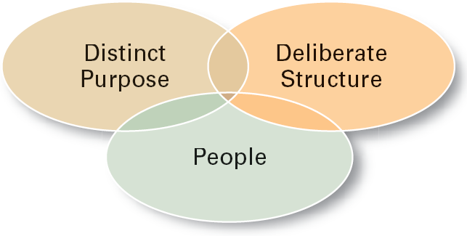
Characteristics of Organizations

Slide 5
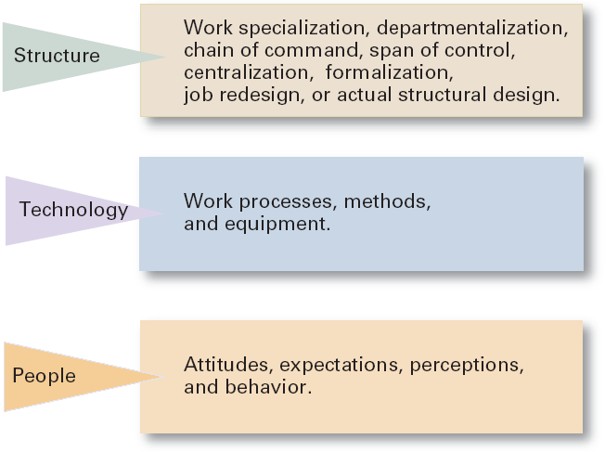
Key Elements of an Organization

Slide 6
Organizational Vision
Organizational Vision
  Reflects management’s aspirations for the organization and its business, providing a view of “where we are going” and giving specifics about its future business plan.
  A strategic vision has much greater direction setting and strategy-making value than the mission statement.

Slide 7
Organizational Mission
Organizational Mission
  Reflects the philosophy and purpose of the organization as defined by top management.
  Tends to deal with an organization’s present business scope and operations – “who we are and what we do.”

Slide 8
Defining stakeholders
A stakeholder is anyone or any group with an interest in the organisation/industry
Some stakeholders are internal and some are external

Slide 9
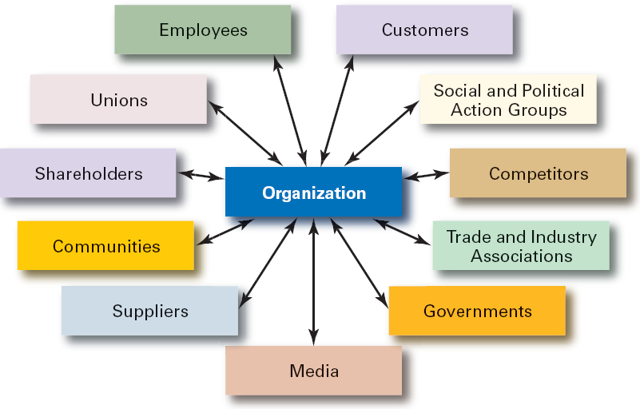
Organizational Stakeholders

Slide 10
Internal and External Stakeholders
Internal stakeholders are those who are ‘members’ of the business organization
Owners and Shareholders
Managers
Staff and employees
External stakeholders are not part of the firm

Slide 11
Internal Stakeholders
Employees
Directors
Shareholders
Trade Unions
Managers
Owners
Employee associations

Slide 12
External Stakeholders
Suppliers
Competitors
Government
Associations
Customers
Banks
Financiers
Society

Slide 13
But…..!
Some groups can be both internal and external stakeholders
Such as staff or shareholders who are also local residents
Can you think of any others?

Slide 14
Summary of Main Teaching Points
  Identify the most common organizational stakeholders.
  Discuss the difference between organizational vision and mission.
  Review the basic and key elements of an organization.

Slide 15
Question and Answer Session
Q & A

Slide 16
Tutorial 2
Briefly explain the following:
Chain of command
Span of control
Work specialisation
Describe the key elements of an organisation and provide the relevant example.
An organisation exists due to its mission or purpose that asks the question ‘Why are we here’ to answer that question, organisations may develop several goals or objectives to translate the mission into some specific measureable performance measures (Annet, 2007).
Compare and contrast between organisational vision and mission.
Describe stakeholders and discuss TWO (2) classifications of stakeholders with appropriate examples.

Slide 17
Next Session
Topic and Structure of next session
NEXT LESSON:
Formation and Classification of Organisations

